Slide 1
Credit Default Risk Prediction
Project Plan
Contributors: Ninad Subhedar and Vaishali Tripathi
Team No.: 5

Slide 2
Use Case
Given a loan application the system predicts if the applicant will be able to repay the loan. The application will contain details that describe the features about the applicant like the income, family details and many more.
ETL Layer will stitch multiple data sources and fills empty values.
Machine Learning layer will train multiple models and outputs the best model.

Slide 3
Data
The data is a combination of multiple data files
Application file
Bureau and bureau balance files
POS cash balance file
Credit card balance file
Previous application file
Installments payments file
Source: https://www.kaggle.com/c/home-credit-default-risk/data

Slide 4
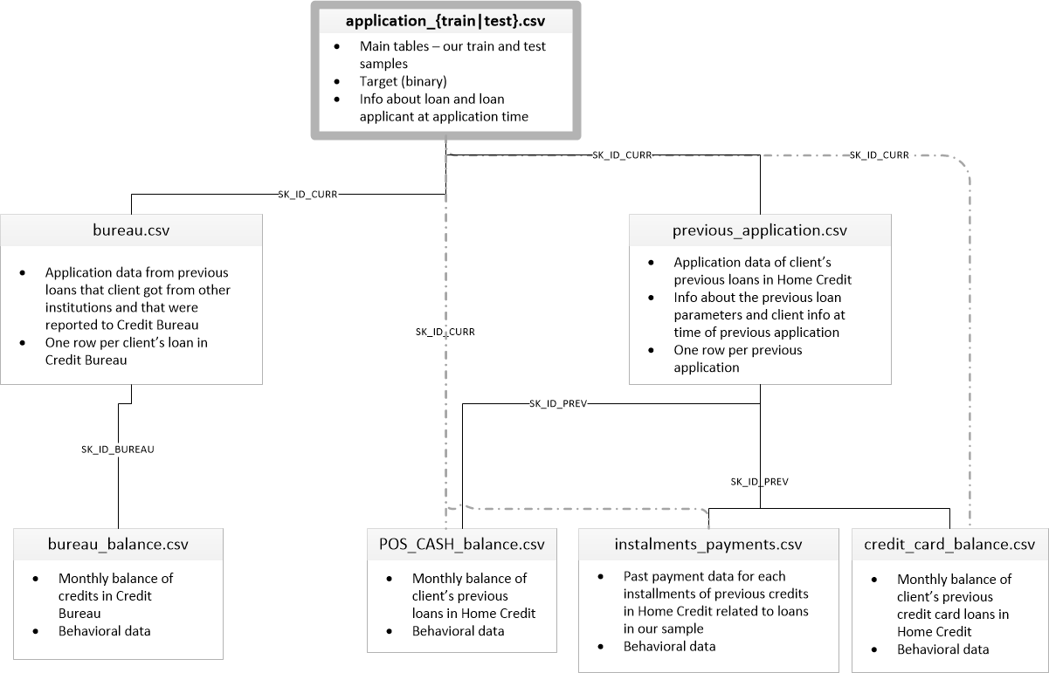
Data

Slide 5
Methodology
Data Source
Data files containing loan applications
ETL
Extract Transform Load
Model
Training Machine learning models
Predictions
Predicting if applicant will default or not
Cross-Validation
Validating the model using cross validation
Data Cleaning
EDA
Evaluating multiple models

Slide 6
Tools
For preforming ETL(Extracting, Transforming, Loading) on data
Utilizing MLlib for training the model and generating predictions.

Slide 7
Milestones
Week 1 – Exploratory Data Analysis
Week 2 – Designing High level Architecture
Week 3 – Designing ETL Logic In Scala
Week 4 – Designing ML Logic for training prediction models
Week 5 – Testing and cross Validating the models

Slide 8
Acceptance criteria
The ETL layer should combine the multiple data sources
The ETL layer should handle null/blank data effectively
The AUC for the ML Model should not drop below 0.6

Slide 9
Thank You

